Slide 1
Do Fairness Benchmarks Agree?
A Cross-Metric Analysis Framework for ML and LLM Bias Auditing
Abdul Azeem Opakunle
DTSC 5505 • Milestone 6 • Benchmarking / Evaluation
Final project presentation and reproducible submission package
Thesis: fairness metrics are not interchangeable; disagreement among them is itself a key audit finding.
DTSC 5505 • Milestone 6
Notes:
Title slide. [Sources] - Project code package and final report prepared for DTSC 5505.

Slide 2
Why this project matters
Fairness auditing is now common, but fairness is not one number.
Organizations are increasingly asked to document bias and fairness in deployed models.
Different metrics encode different notions of harm: outcome parity, error parity, or meaning of positive predictions.
A model can look acceptable on one metric and problematic on another.
FairEval asks a practical question: do our fairness benchmarks agree strongly enough to support simple conclusions?
Audit perspective
Compute several fairness metrics
Compare model rankings
Measure agreement explicitly
Report uncertainty honestly
DTSC 5505 • Milestone 6
Notes:
[Sources] - Conceptual framing from the FairEval final report; fairness definitions summarized from standard fairness literature.

Slide 3
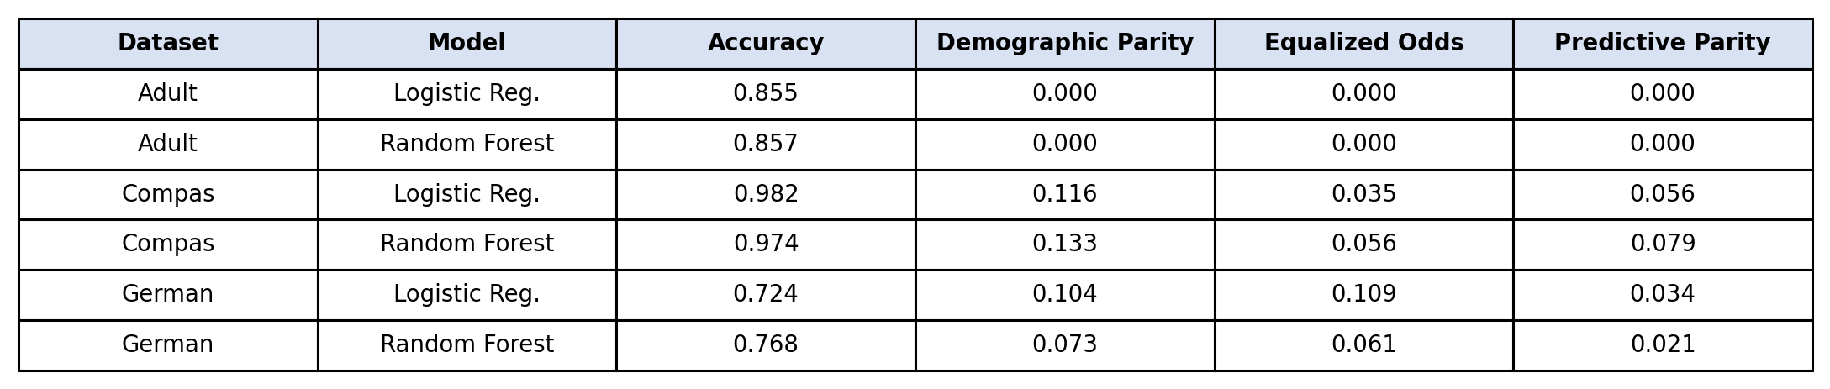
Datasets and benchmark scope
Three validated tabular benchmarks, plus two packaged LLM benchmark datasets for extension.
Adult: income prediction benchmark; sensitive attribute in code = sex.
COMPAS: recidivism benchmark; sensitive attribute in code = race.
German Credit: credit-risk benchmark; sensitive attribute derived from personal status.
CrowS-Pairs and BBQ are included in the package for optional LLM benchmarking.
Validated empirical claims in the final report use the tabular branch.
DTSC 5505 • Milestone 6
Notes:
[Sources] - Packaged datasets included with the Milestone 6 submission.

Slide 4
System design and execution pipeline
The benchmark is modular, scriptable, and designed for reproducibility.
Load
datasets
Preprocess
features + groups
Train
models
Compute
metrics
Save outputs
+ figures
Main modules: data_loader.py, preprocessing.py, models.py, fairness_metrics.py, experiments.py, agreement.py
Reproducibility features: packaged CSV datasets, saved outputs, script-generated figures, dependency files, README instructions, and separate scripts for presentation and code-demo recordings.
DTSC 5505 • Milestone 6
Notes:
[Sources] - Project source tree in the submission zip.

Slide 5
Metrics used in the final benchmark
Three fairness metrics plus two agreement statistics.
Fairness metrics
Agreement analysis
Demographic parity difference: disparity in positive prediction rates across groups.
Equalized odds difference: disparity in error behavior, combining TPR and FPR gaps.
Predictive parity difference: disparity in positive predictive value across groups.
Kendall's tau: do two metrics rank the models in the same order?
Krippendorff's alpha: do the fairness metrics show overall consensus as model “raters”?
Key thesis: disagreement among metrics is itself a meaningful audit output.
Lower disparity values are better, but the metrics still represent different normative commitments.
DTSC 5505 • Milestone 6
Notes:
[Sources] - Metric definitions summarized from the final report and standard fairness literature.

Slide 6
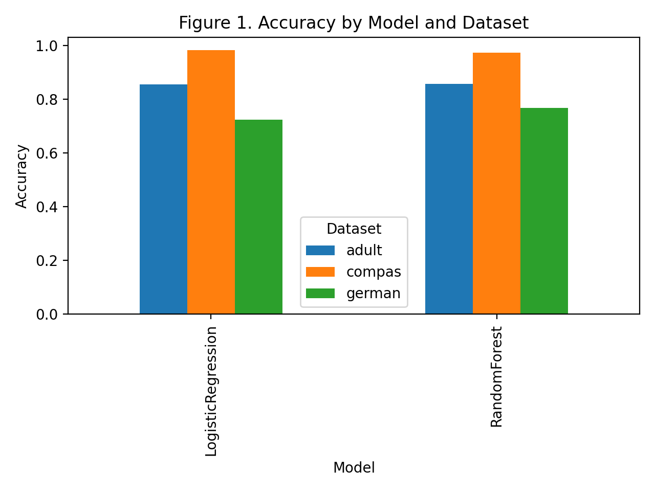
Predictive performance results
Accuracy varies much more by dataset than by model.
Adult: both models around 0.856 accuracy.
COMPAS: both models above 0.97 accuracy.
German Credit: lower overall performance, with random forest higher than logistic regression.
Takeaway: dataset difficulty dominates small differences between the two baseline models.
DTSC 5505 • Milestone 6
Notes:
[Sources] - Figure generated from outputs/results.csv in the final submission package.

Slide 7
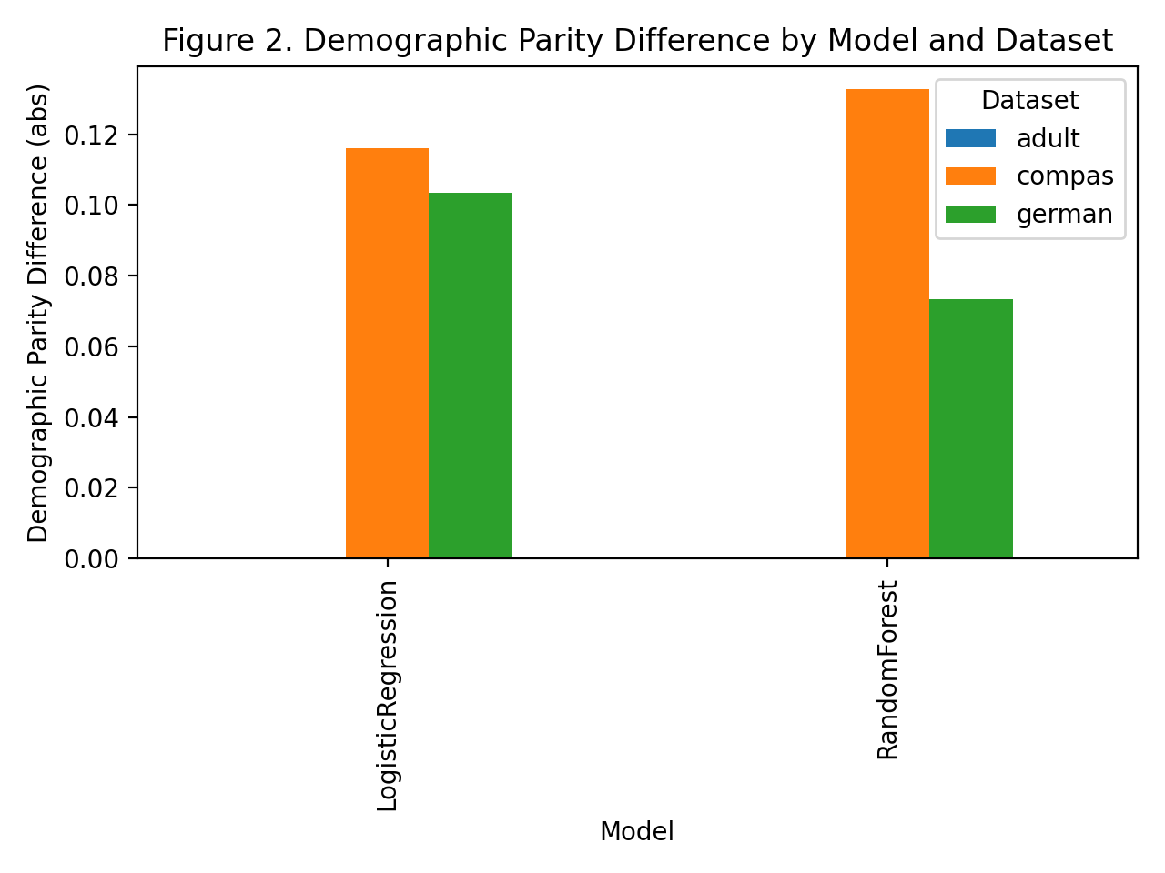
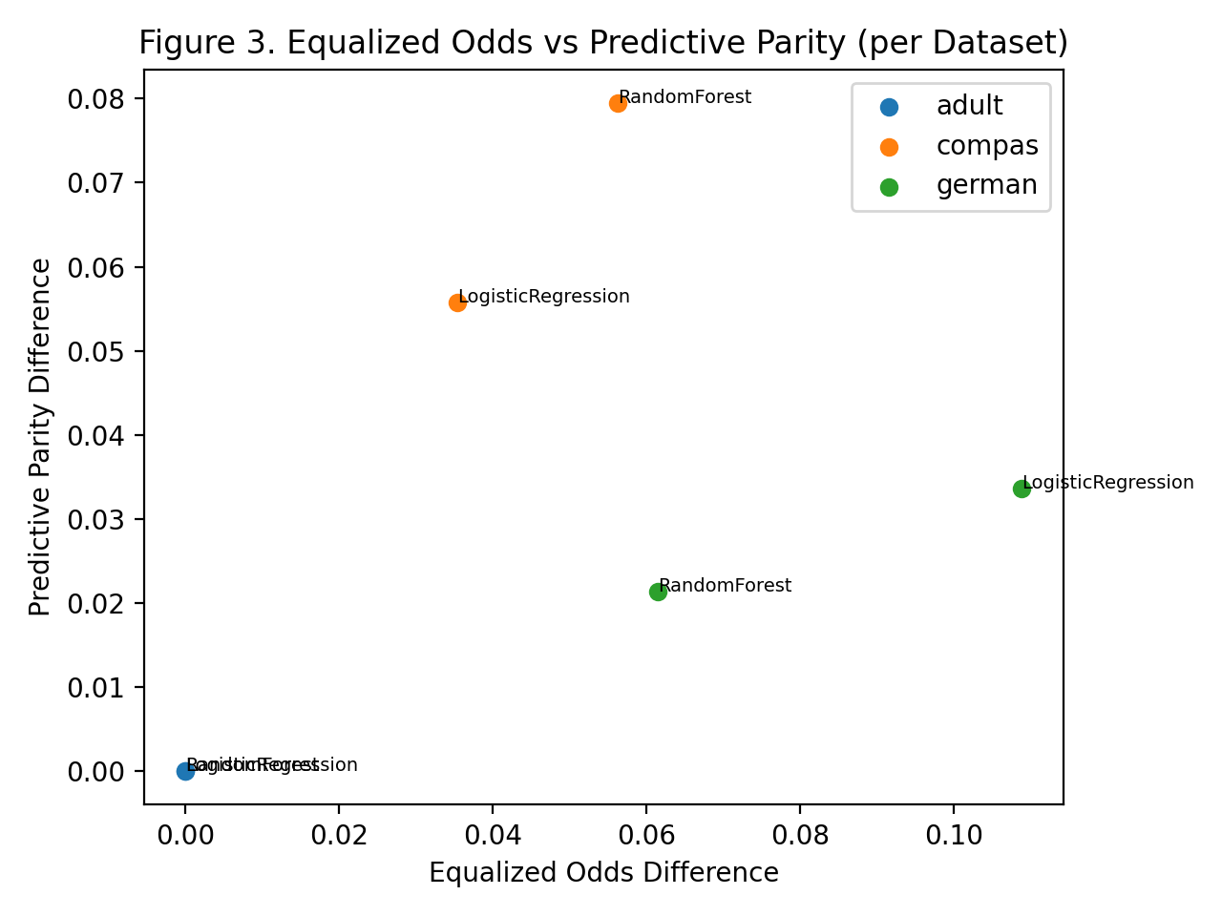
Fairness results are dataset-dependent
Single-metric summaries hide important differences across datasets.
Adult: all three fairness disparities evaluate to 0.000 in the packaged results.
COMPAS: non-zero gaps across all three fairness metrics; random forest is worse than logistic regression on each one.
German Credit: demographic parity stays small, but equalized odds is noticeably larger—especially for logistic regression.
Interpretation: the “fairest” model depends on which fairness definition is prioritized.
DTSC 5505 • Milestone 6
Notes:
[Sources] - Figures generated from outputs/results.csv in the final submission package.

Slide 8
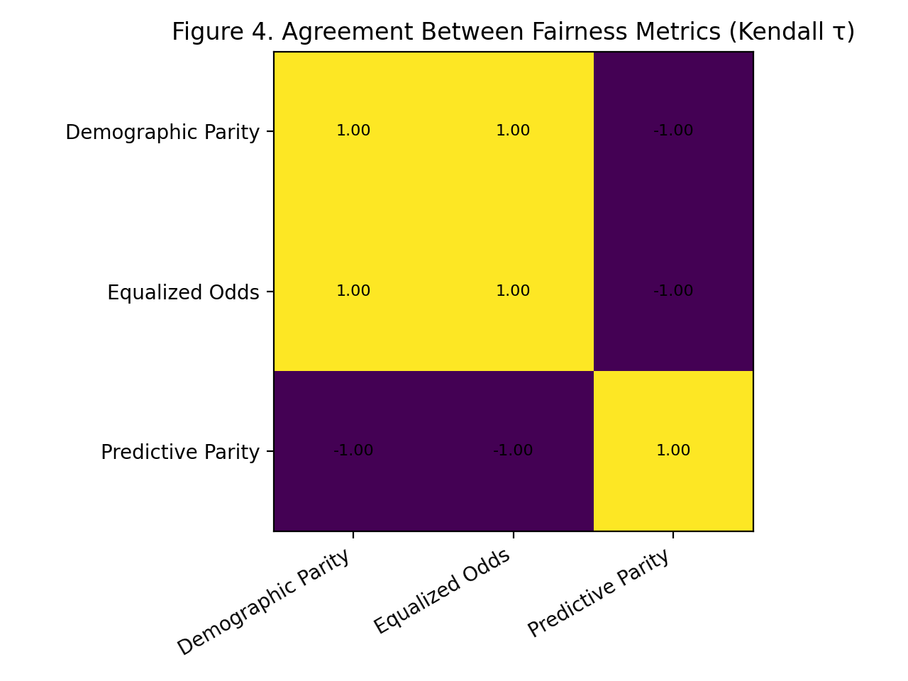
Agreement analysis: the core empirical finding
The metrics do not provide strong overall consensus.
Krippendorff's alpha = -0.111
Demographic parity and equalized odds agree perfectly in the aggregated ranking (tau = 1.0).
Predictive parity moves in the opposite direction (tau = -1.0 against the other two metrics).
Negative alpha indicates weak overall consensus among the fairness metrics.
Therefore fairness auditing should report disagreement explicitly, not collapse everything into one score.
DTSC 5505 • Milestone 6
Notes:
[Sources] - Figure generated from outputs/agreement_kendall_tau.csv and outputs/agreement_krippendorff_alpha.txt.

Slide 9
Milestone 6 deliverables and reproducibility
The final package is organized for grading, inspection, and rerun.
Final report (.docx)
Presentation slides (.pptx)
Runnable code package (.zip)
Datasets included
Updated README + environment files
Presentation narration script
Code walkthrough / demo script
Two items must still be recorded by the student: the presentation video and the live code walkthrough / execution demo.
DTSC 5505 • Milestone 6
Notes:
[Sources] - Milestone 6 assignment requirements and the prepared submission package contents.

Slide 10
Limitations and next steps
The benchmark is useful and reproducible, but it is not yet the full end-state roadmap.
Validated empirical benchmark is still small: two model families and three tabular datasets.
Sensitive-attribute grouping is coarse and does not address intersectional or subgroup analysis.
No confidence intervals, repeated-split stability analysis, or mitigation baselines yet.
Optional LLM benchmark adapters are packaged, but authenticated API execution is not part of the final validated results.
Next steps: expand models, add more fairness criteria, complete the LLM branch, and implement an LLM-as-a-Fairness-Judge module.
Even with these limits, the current artifact shows why fairness evaluation should be treated as multi-metric diagnosis.
DTSC 5505 • Milestone 6
Notes:
[Sources] - Limitations summarized from the final report.

Slide 11
Conclusion
What the final benchmark demonstrates.
Bottom line: in the final FairEval benchmark, fairness metrics do not agree strongly enough to justify a simple one-number fairness story.
The project contributes a coherent, reproducible benchmarking artifact.
Agreement analysis converts a theoretical concern into a measurable audit output.
Future work will extend the framework toward a more complete cross-modal fairness benchmark.
Thank you.
DTSC 5505 • Milestone 6
Notes:
[Sources] - Final report conclusion and packaged benchmark outputs.

